Slide 1
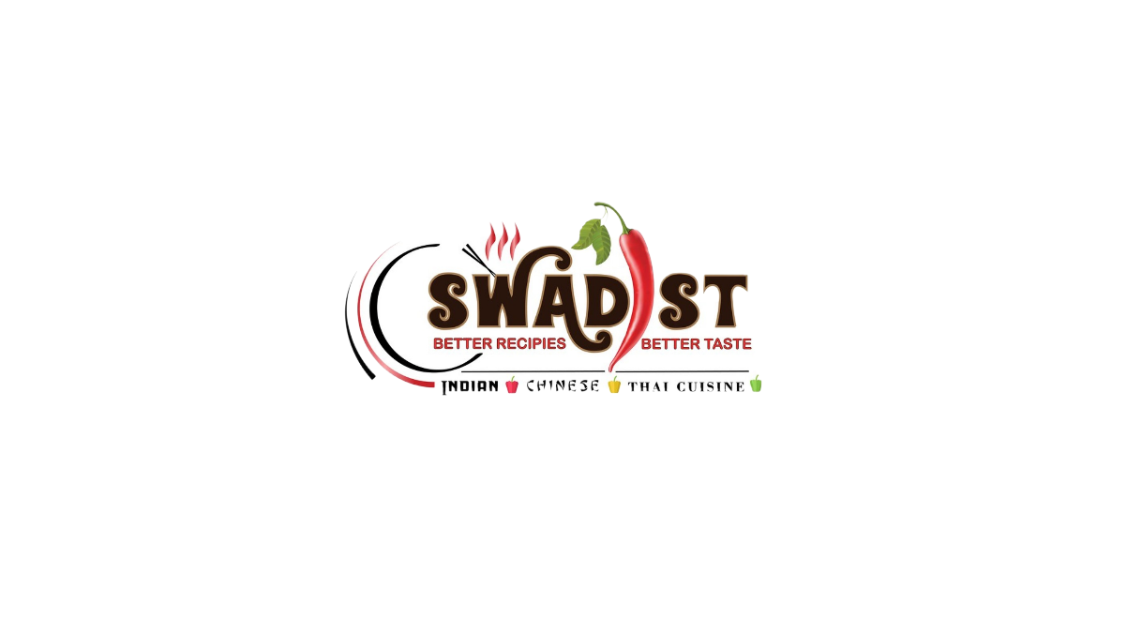

Swadist
An Indian Restaurant
BIA 672 – Marketing Analytics
Prof. Khashayar Dehnad
Team Members:
Rahul Surve
Sarthak Dhaneshwar
Omkar Kurhade
Shubham Neema
Pranita Khamkar

Slide 2
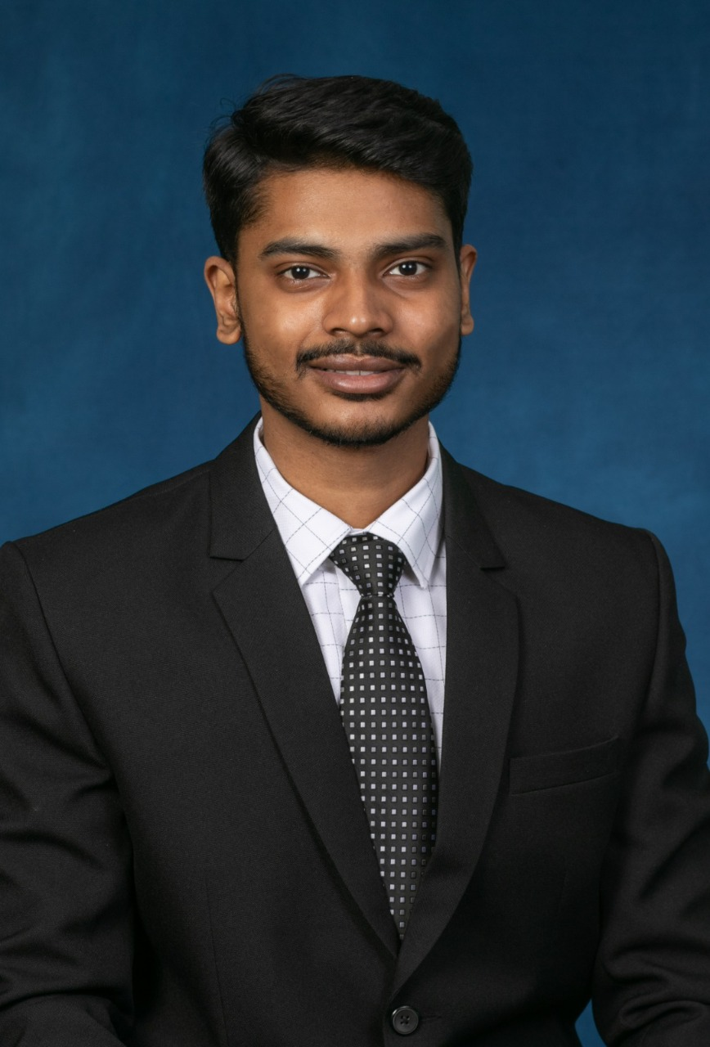
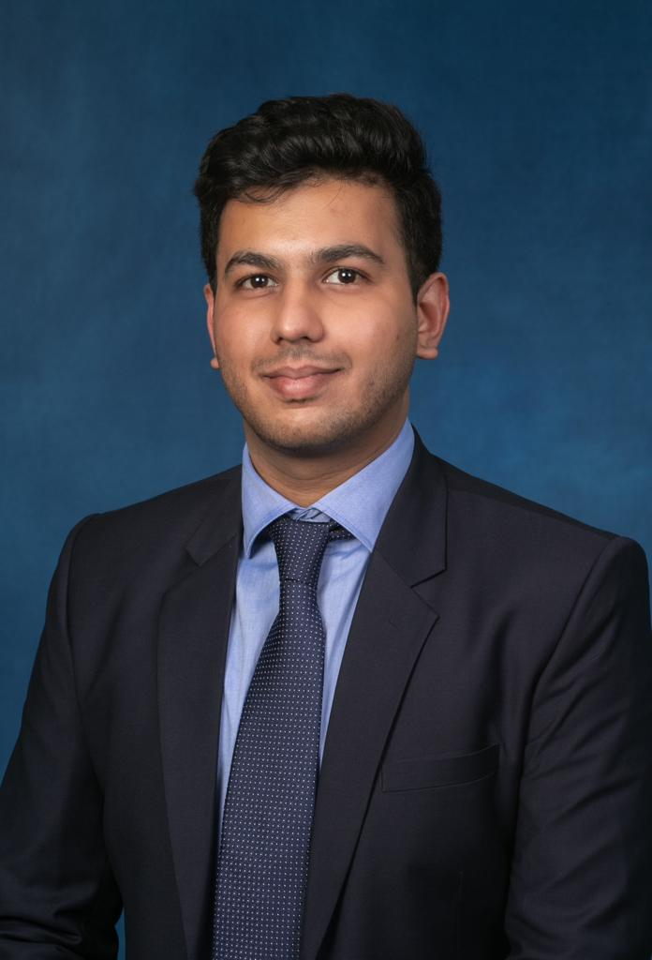
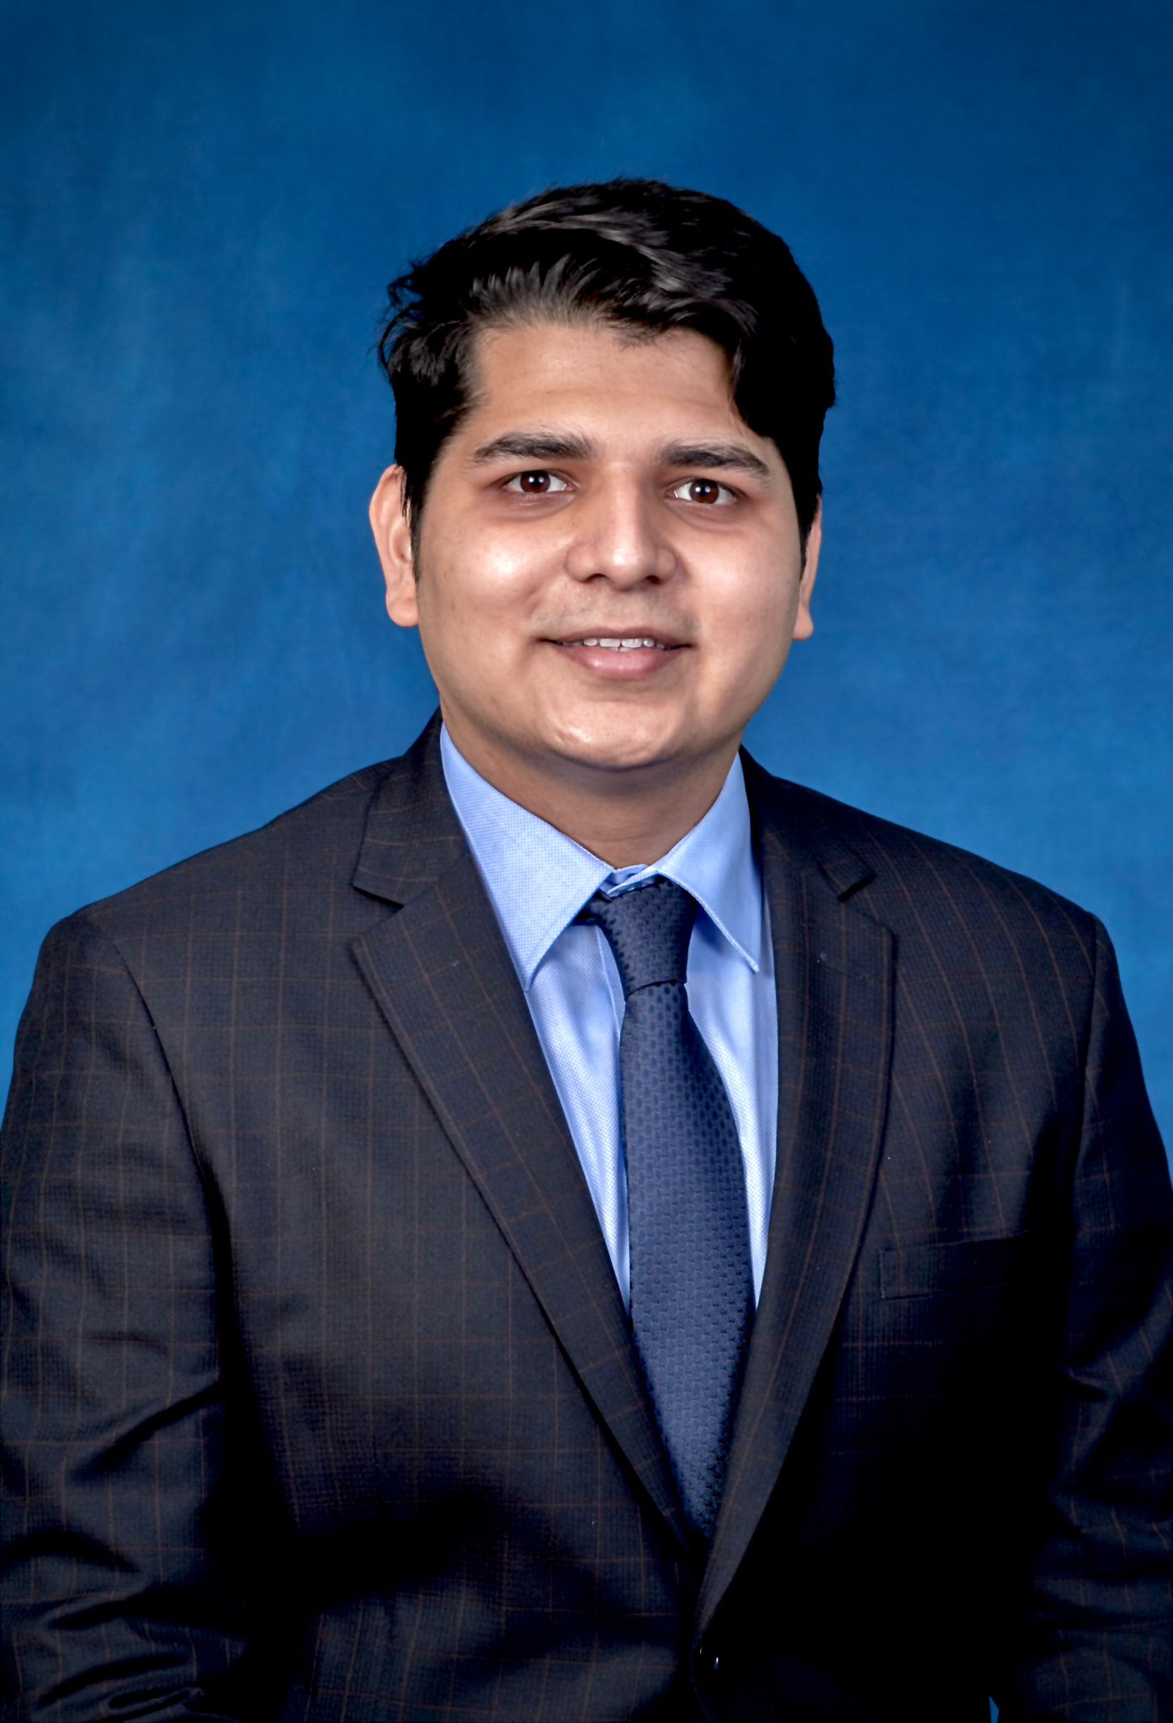
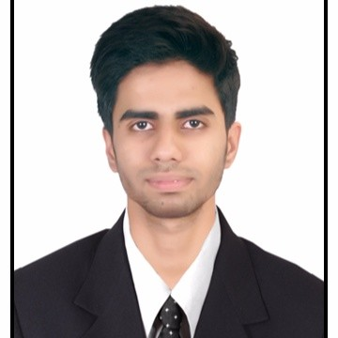
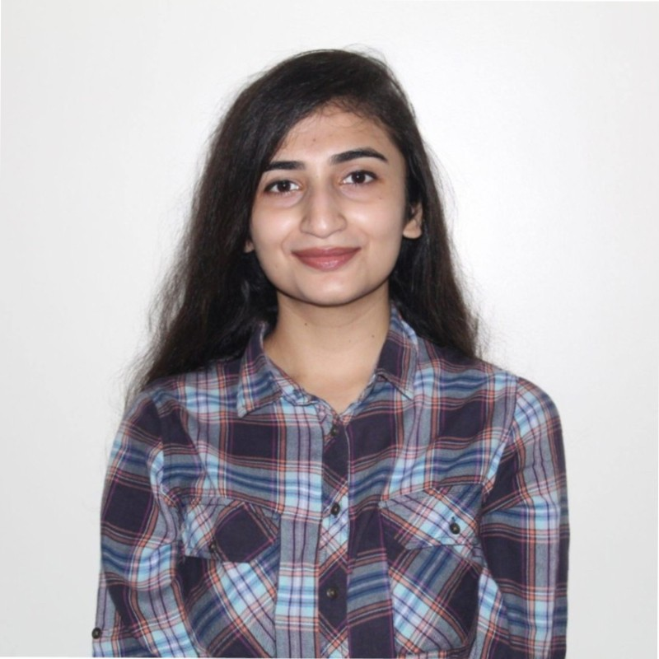
TEAM MEMBERS
Rahul Surve
10475549
Sarthak Dhaneshwar
10474238
Omkar Kurhade
10475374
Shubham Neema
20007579
Pranita Khamkar
10476826

Slide 3
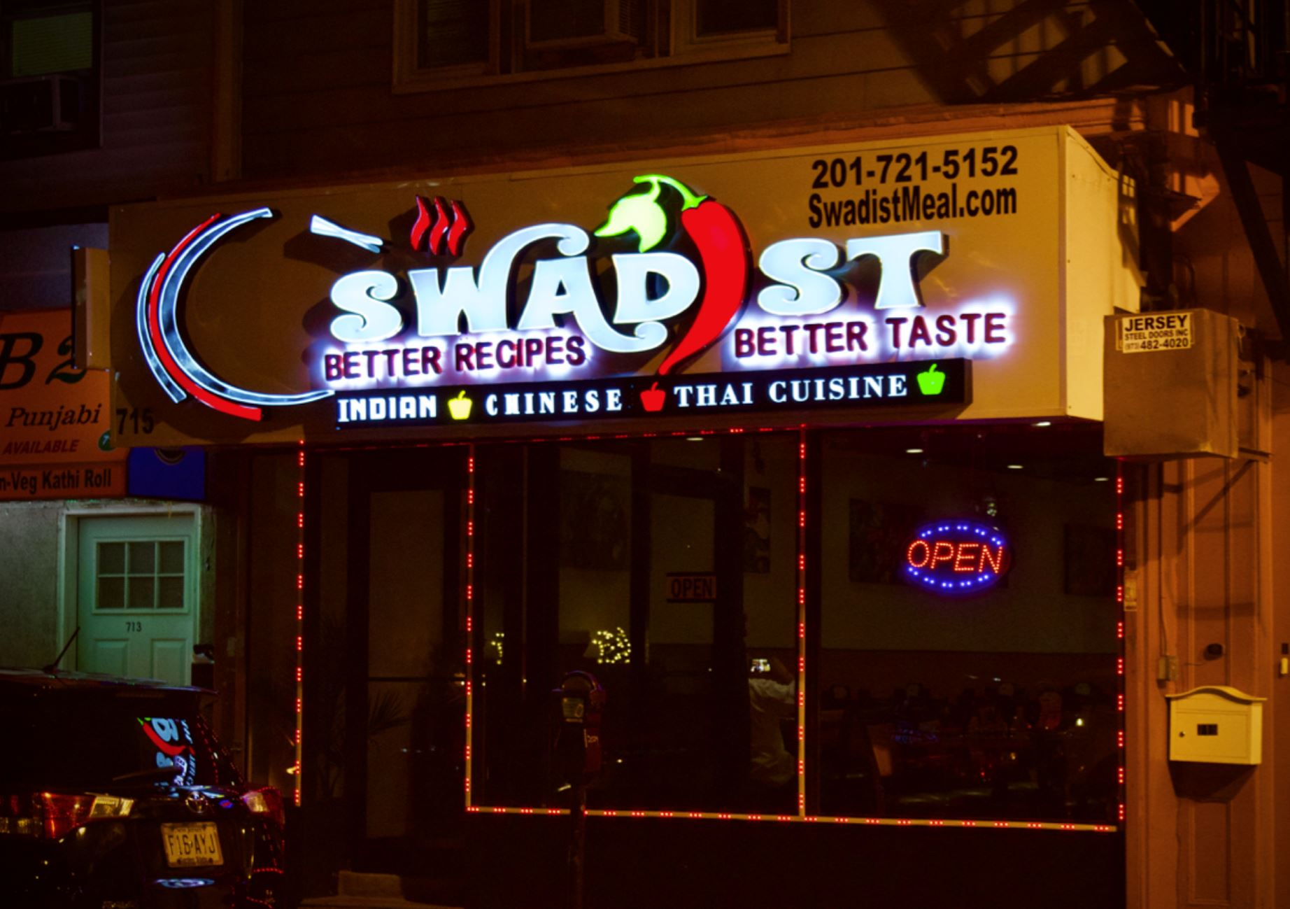
ABOUT SWADIST
Swadist is a restaurant on Newark Street at Journal Square, New Jersey owned by Uttam Rawat.
Swadist is a Sanskrit word that means tasty and delicious, hence the name of the restaurant.
It is well-known for serving authentic Asian cuisine (Indian, Chinese, Thai)
The restaurant has scaled over the years from being a small food joint to a popular dine in place with a capacity of 80 guests at a time.

Slide 4
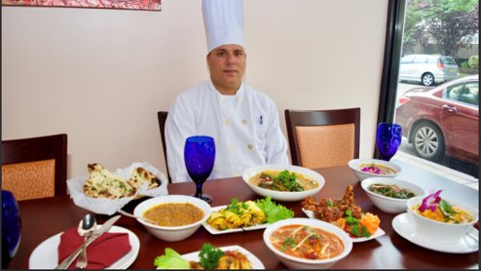
UTTAM RAWAT - SWADIST'S OWNER AND HEAD CHEF
"The best compliment we can receive is the referral of your friends and family"

Slide 5
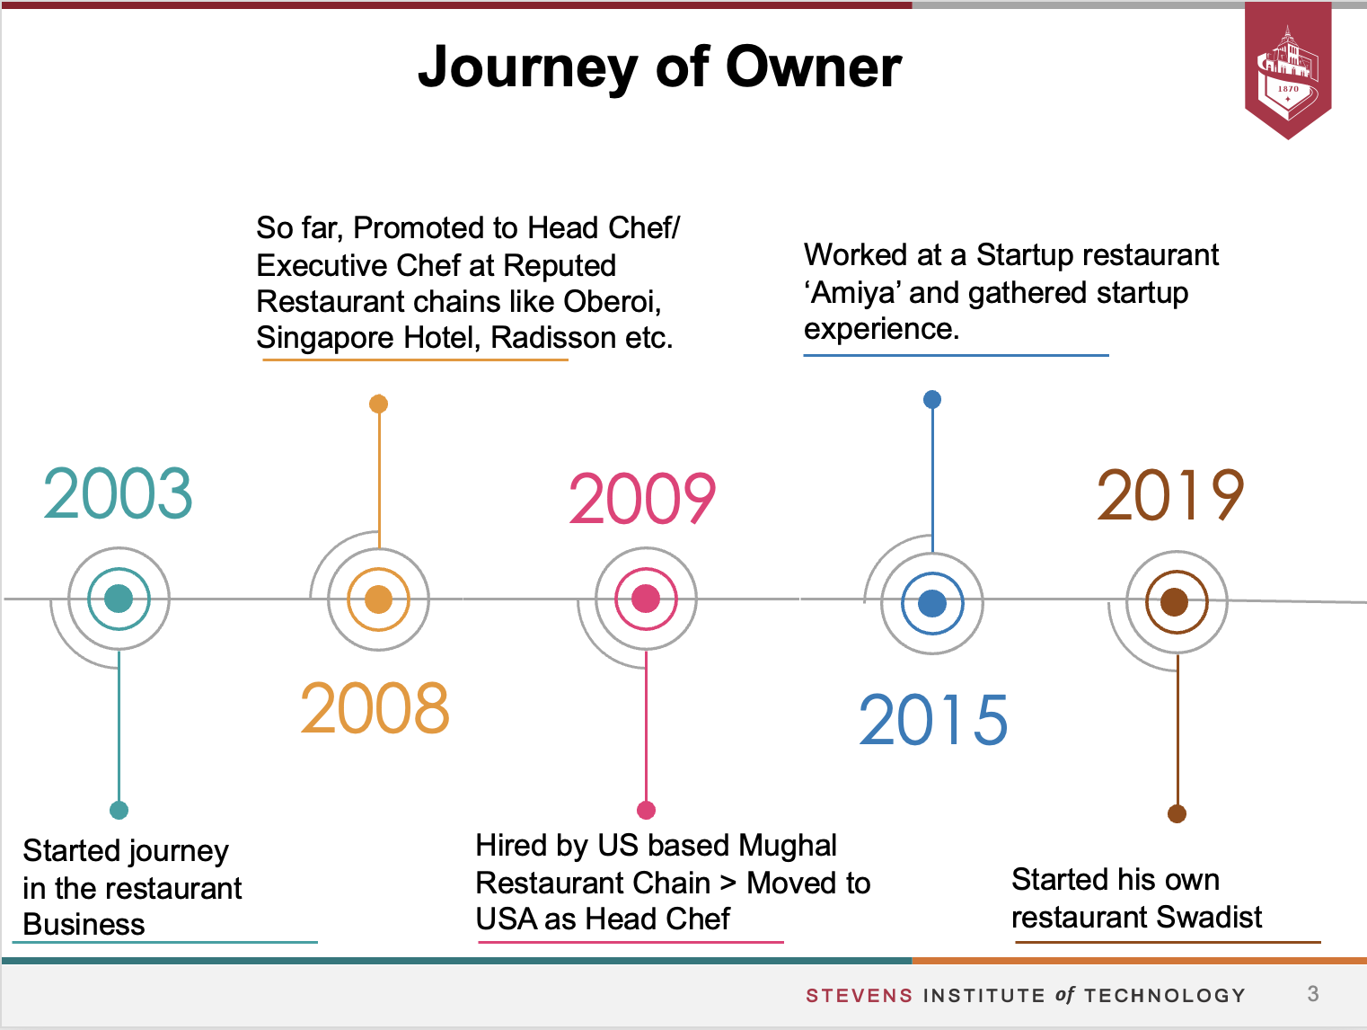


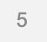
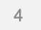
JOURNEY OF RAWAT

Slide 6
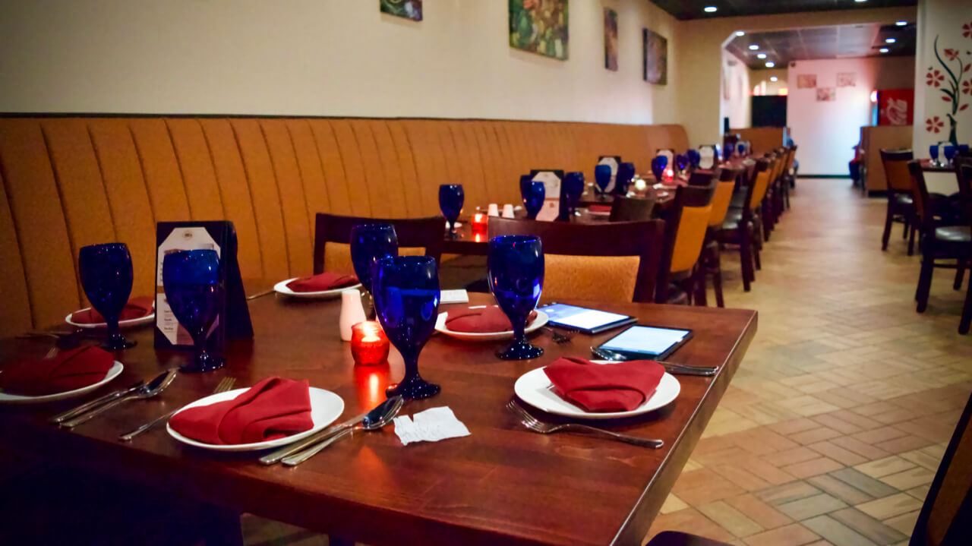
BACKGROUND OF SWADIST
Uttam Rawat opened his own restaurant, SWADIST in August 2019.
His total investment in the business is a little over half a million dollars.
Swadist is known for its delicious Butter Chicken, Drums of heaven and Garlic Naan
He believes that the restaurant's success is due to its good quality meals and mouth to mouth publicity.

Slide 7
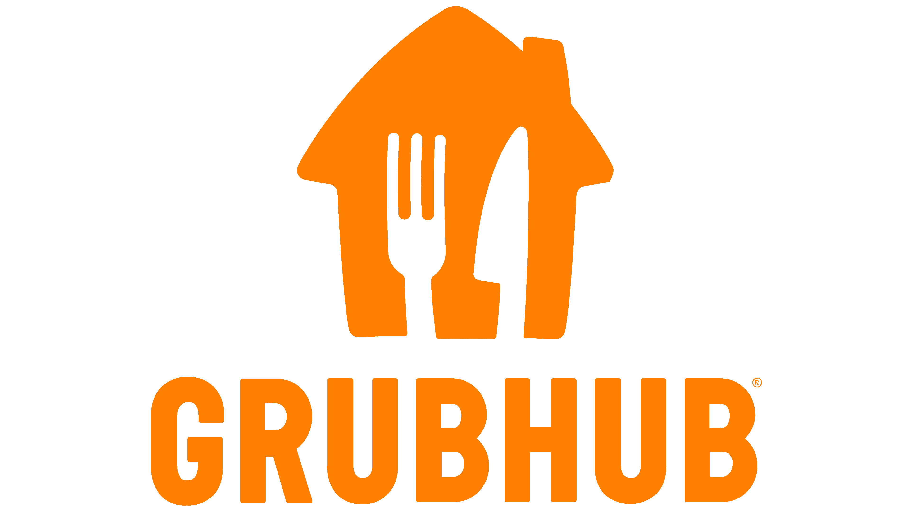


TRANSITION TO THE DIGI-WORLD
Pre-pandemic, the restaurant had no presence on any online food platforms (Grub hub, UberEats, Doordash)
However, with lockdown and dwindling sales revenue the restaurant was forced to sell on these platforms.
With the addition of these online portals to the portfolio, the restaurant increased its gross profit by 20% in the first-year post pandemic.

Slide 8
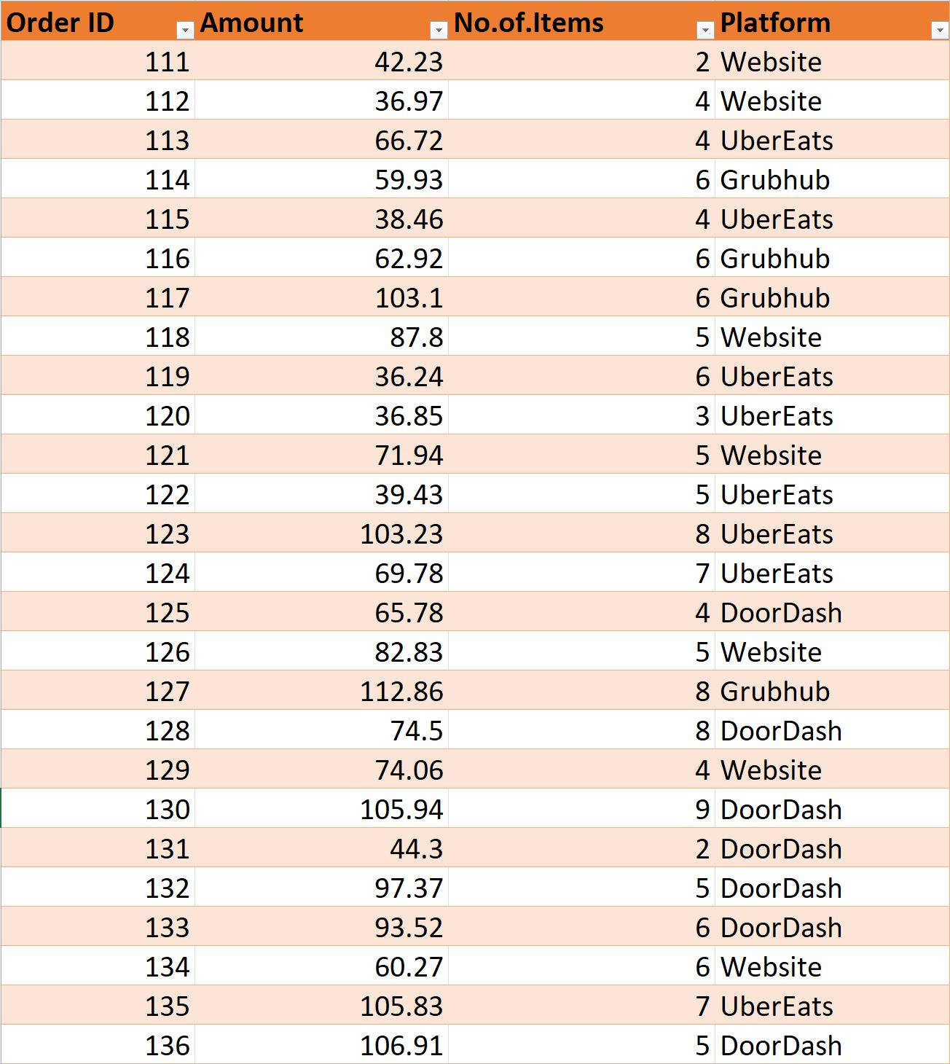
DATA
We gathered information by scanning receipts provided by the owner.
We were provided a total of 722 receipts, of which we only used 569 for our three-month project because the owner did not keep track of records.
The project only factors food ordered through mediators and Swadist's website.

Slide 9
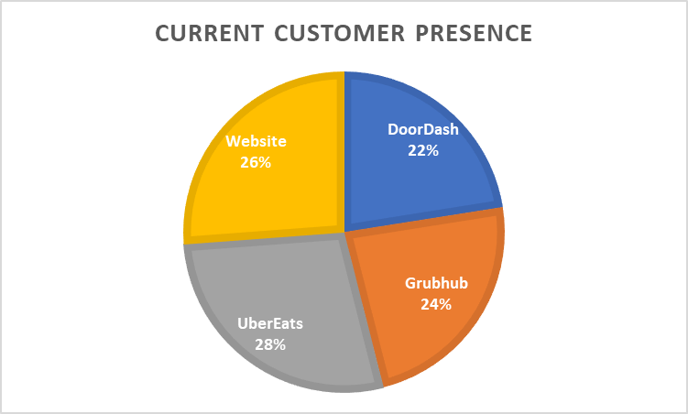
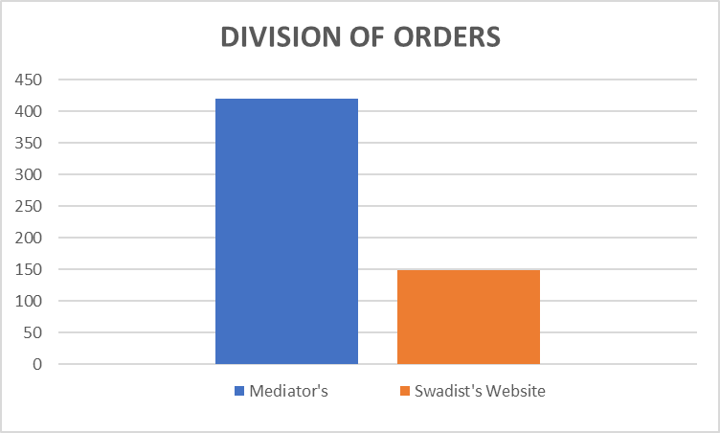
ORDER DEMOGRAPHICS
Currently, food is being ordered in the above manner.
Out of the total 569 orders, 149 are website orders and 420 are orders placed through Grubhub, Doordash and UberEats.

Slide 10

SALES / MARGINS
The total restaurant sales on the first day were $92.
The owner recalls first year sales being $15k.
The business suffered due to COVID restrictions which halved its total revenue.
After tallying, Christmas week ushered in a surge in sales that lasted through the months of January, February, and March.
The restaurant's total revenue for the previous month was $43,175.
76% orders came through intermediaries such as GrubHub, remaining 24% were place via Swadist's website.
The margin is 62% if the order is placed through the company's website and 34% if the order is placed through a third-party vendor.

Slide 11
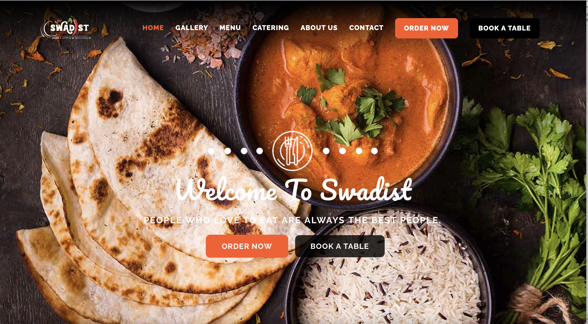
CURRENT MARKETING STRATEGIES
The restaurant runs ads on Facebook, Yelp, Google platforms and Groupon.
Its website - swadist.com which started in 2020, has negligible organic interactions.
Swadist, which is popularly known for its food quality, also has its own catering service.
The owner believes the catering business generates more mouth publicity in a day which usually takes couple of weeks to achieve and contributes to total revenue.

Slide 12
SHORT TERM GOALS
According to our findings and estimations, only 24% of orders come via the Swadist Website. More orders from the Swadist website are required to improve gross revenue.
Digital marketing and paid search marketing should be used to shift consumer base to Swadist Website.
Customers should be recommended customized deals depending on their previous orders using data analysis.
The Swadist website's user interface can be improved so that users can see what they have ordered the most, their most recent order, and ideas regarding what they would like.
Currently, Swadist is more focused towards North indian food, they can add south indian dishes such as Masala dosa, idli sambhar etc to their menu to provide wide variety of options to the customer.
Live Guitar gigs can also attract more number of customers and can also help in mouth publicity.

Slide 13
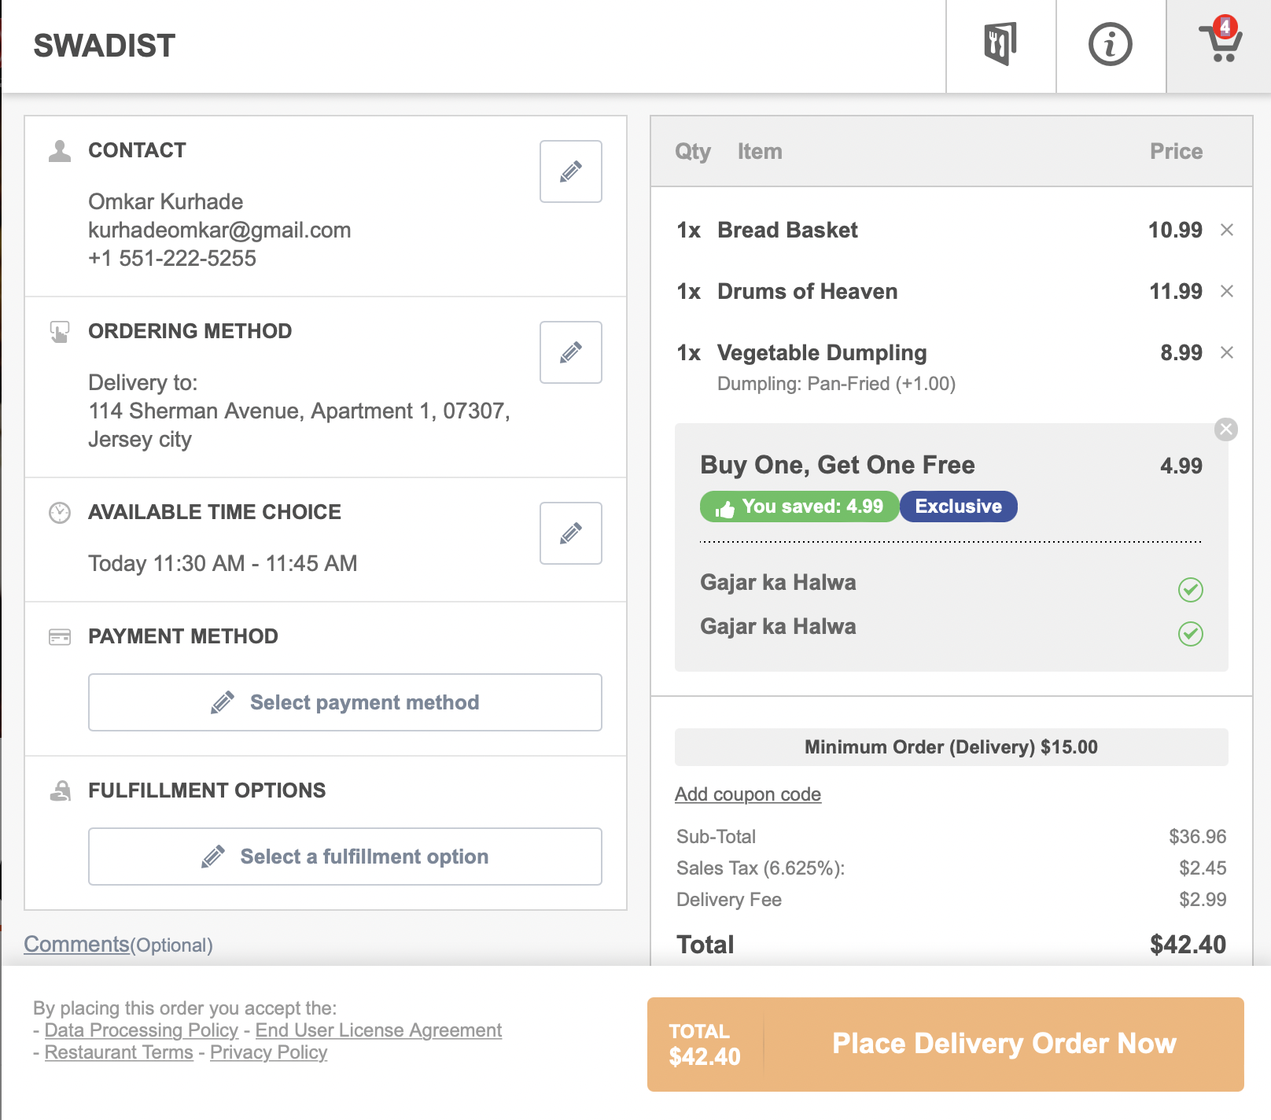
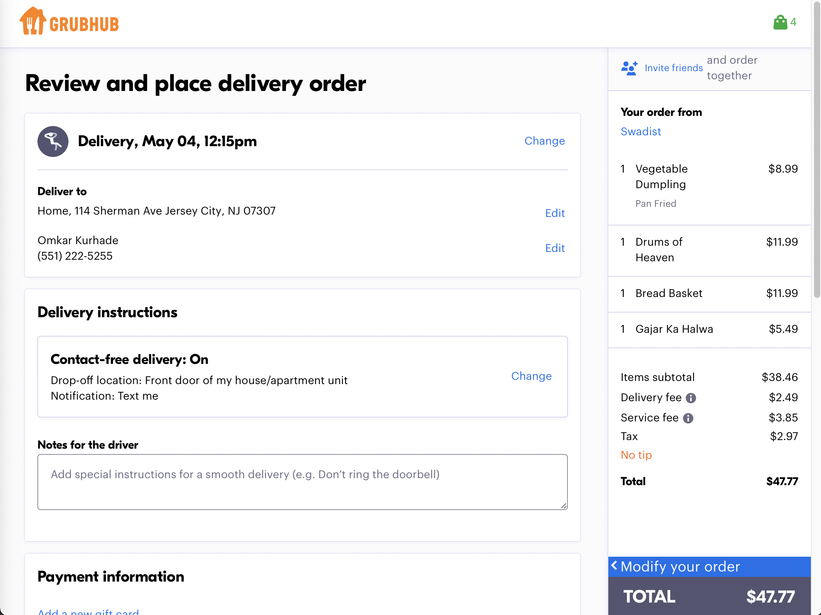
DIFFERENCE IN COST TO CUSTOMER
Intrinsic value of goods received by customer is $36.96 + $5(Discount) = $41.96.
The customer only pays 1% extra over intrinsic value to get their food delivered.
Intrinsic value of goods received by customer is $38.46.
The customer pays 19% extra over intrinsic value to get their food delivered

Slide 14
SWOT ANALYSIS: ORDERS VIA RESTAURANT'S WEB PAGE OVER OTHER MEDIATORS
S
W
Strengths
Weaknesses
Earning larger gross margins, which we may miss out on if we do the majority of our sales through a middleman.
Huge investment in owning and maintaining delivery fleet
SWOT
Opportunities
Threats
Build loyal customer base.
Incurring losses if we are unable to manage the operational side of the firm.
O
T

Slide 15
SWOT ANALYSIS: ORDERS VIA MEDIATORS OVER RESTAURANTS WEBPAGE
S
W
Strengths
Weaknesses
No investment required for owning and managing delivery fleet
If the mediator's algorithms disregard our restaurant, sales will drop.
SWOT
Opportunities
Threats
Increased reach as a result of mediators' access to a big consumer pool.
Losing larger gross margins that could have been obtained through the restaurant's website
O
T

Slide 16
HOW CAN WE GET MORE TRAFFIC TO SWADIST'S WEBSITE?
Give additional offers to attract customers.
With each delivery, add a pamphlet of advertising Swadist website.
Paid search advertising and digital marketing to reach a greater number of customers.
User interface can be improved by showing the frequent and most popular orders for the target user.
Based on your previous orders, customized offers can be suggested to customers.

Slide 17
STRATEGIES TO FIND TARGET CUSTOMER
Conduct interview and service.
Consider launching products which are popular among competitors
Apply SEO tools to analyze website visitors.
Leverage customer data.
Get your products in user's hand.
Check your competitors.
Listen to social media.
To create buyer's persona.

Slide 18
OPERATIONAL COSTS
Grubhub Order Value – $47.77 out of which restaurant gets $38.46.
From this $38.36 only 34% is profit on average according to the owner, thus he earns $11.4 on this transaction
Swadist Order Value – On a $42.40 bill, the restaurant gets $39.9 out of which gross margin is 62% which in turns gives the owner $24.74
Average Cost of 1 electric scooter with a 60mile range is $2000. If the restaurant decides to start its own delivery system with 4 such vehicles, initial cost of owning them is $8000.
Recurring cost of 4 drivers would come to $7,680 for a month on a $12 hourly salary. The owner earns $6,600 only through delivery fee on the website.
After initial analysis, average bill is $76. Now, the owner earns 28% more if customers order through website, a profit of $21.

Slide 19
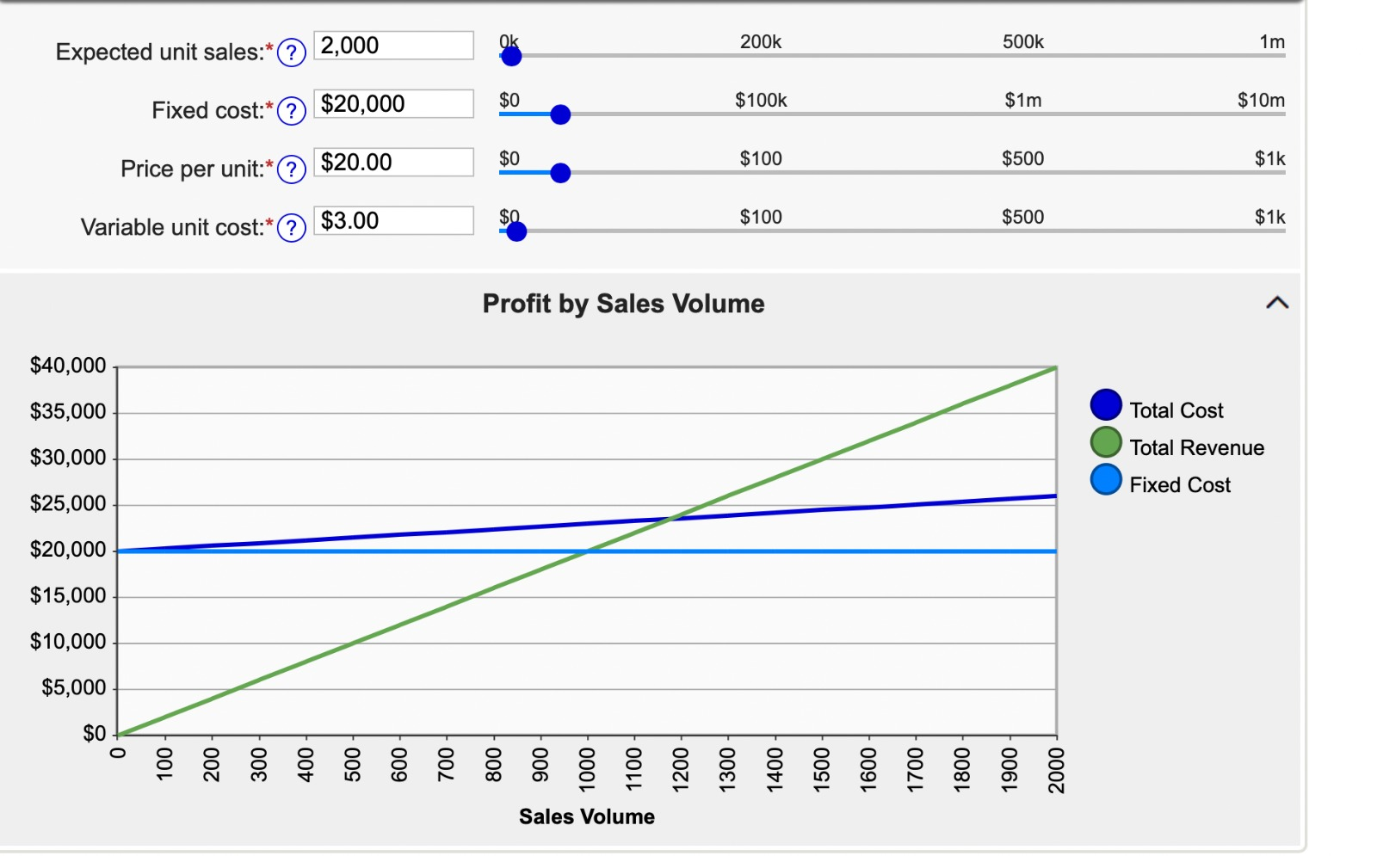
BREAK – EVEN POINT
Fixed Cost - $20,000 (To own delivery Fleet)
Variable Cost - $3 (Per order delivered)
Break-even Point – Approximately 1200 Orders

Slide 20
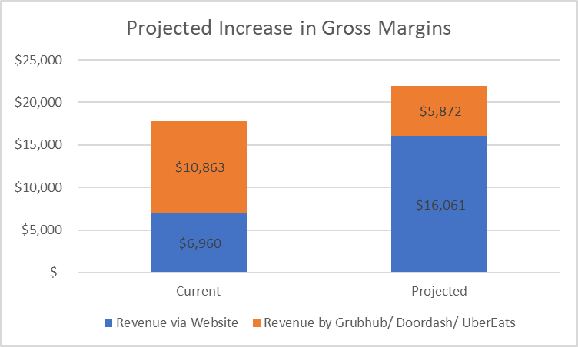
PROJECTED INCREASE IN GROSS MARGINS

Slide 21
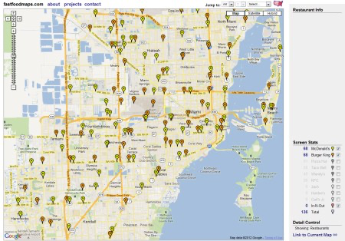
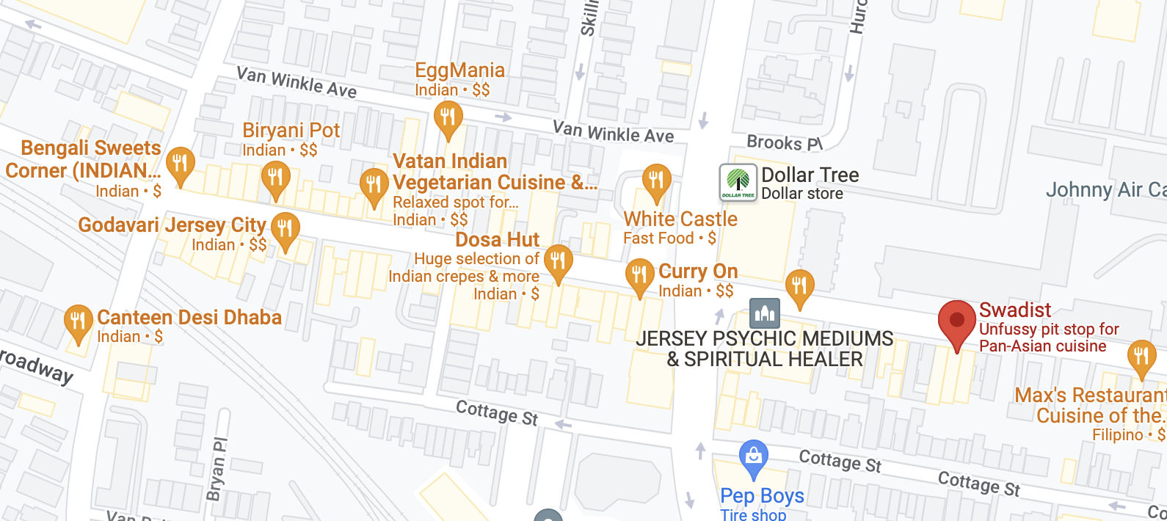
GAME THEORY : LOCATION
Two stores competing should cluster in a central location as a result of competitive forces.
Adding on this idea, Swadist being an Indian Cuisine Restaurant, if its location is nearer to other Indian Cuisine restaurants, it would be beneficial for all the restaurants present in the cluster.
There are many factors that play into account such as,
The customer being tempted to try a new restaurant.
The waiting outside a different restaurant could compel customers to come to our restaurant.
Cluster of Indian Restaurants.
Swadist's Location

Slide 22
SUMMARY
Based on our research and analysis, we can conclude by saying that first and foremost, we need to increase traffic to Swadist's own website, which will help generate more profit.
Second, Swadist must introduce the food items that its competitors sell the most in order to acquire the attention of a consumer base for e.g., South Indian cuisine.
One of the most important aspects that Swadist must improve is its location, which is currently far from cluster of Indian restaurants.
Finally, to improve consumer satisfaction, a mobile application should be launched, and the website's user interface should be improved.

Slide 23
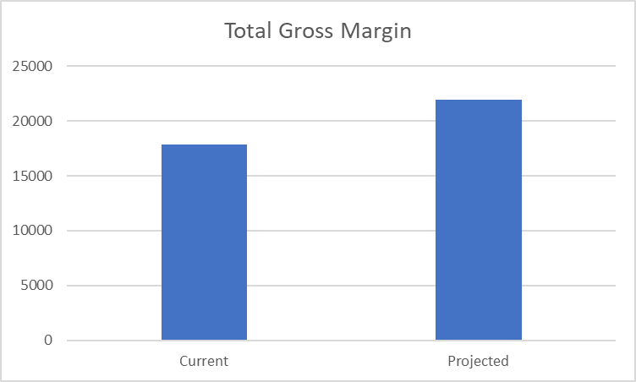
CONCLUSION
Swadist should reduce their reliance on food applications and increasing traffic to their own website, they can gain a higher margin on their orders.
By doing so the gross margins which are $17,823 can be increased to $21,993.
Projected increase in gross margin is 23%

Slide 24
ASSUMPTIONS
If we can manage to increase traffic to Swadist website around 60-40 ratio, 60 from swadist and 40 from Grubhub, Doordash etc.
We didn’t consider pandemic such as covid in our calculations.
We assume that the overall number of orders catered by the restaurant will remain constant, therefore making the aforementioned adjustments and redirecting visitors to the business's website will have no effect on the total number of orders catered by the restaurant.

Slide 25
REFERENCES
https://productmint.com/the-grubhub-business-model-how-does-grubhub-make-money/
https://www.forbes.com/sites/theyec/2021/10/04/eight-effective-strategies-for-identifying-your-target-customers/?sh=7d3d14961c70
https://swadistmeal.com
https://mindyourdecisions.com/blog/2012/10/23/why-are-mcdonalds-and-burger-king-usually-located-near-each-other-fast-food-location-game-theory/

